Slide 1
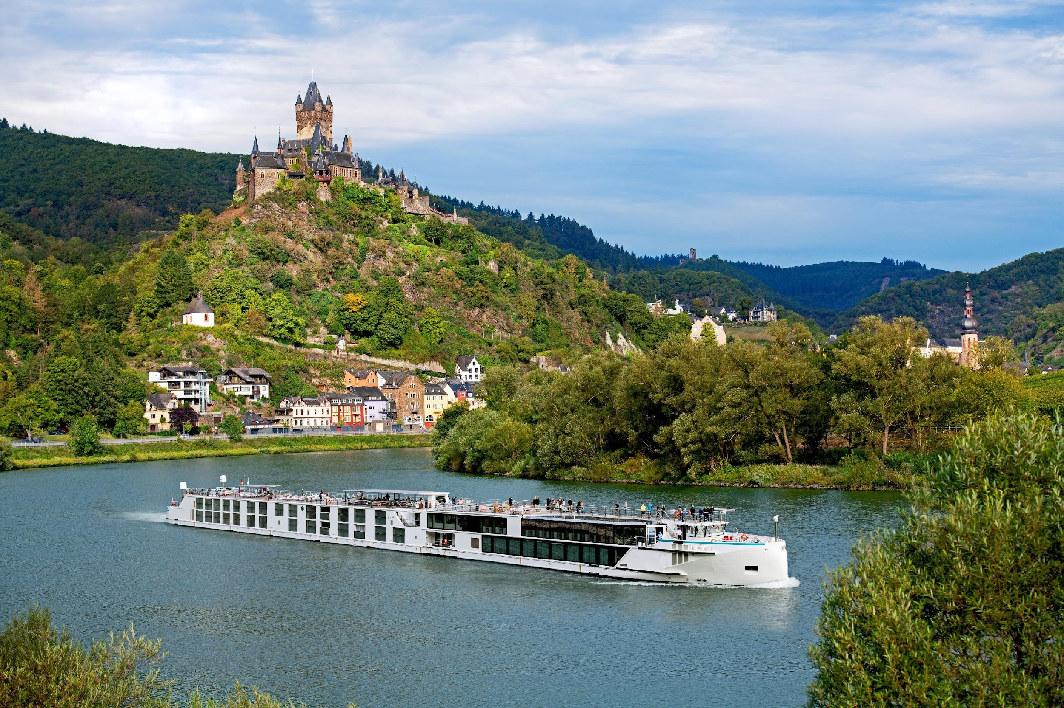
Notes:
Photocredits: © Claus Brechenmacher & Reiner Baumann Photography
© AD Associates LLP 2022 / © Ian Schemper Photography

Slide 2
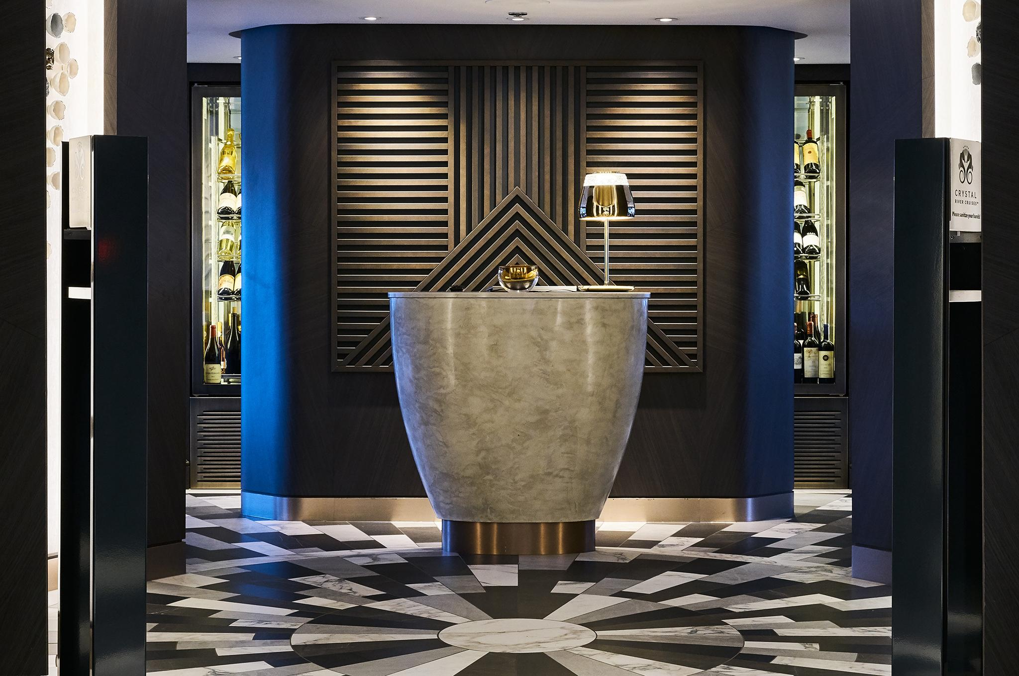
The Restaurant

Slide 3
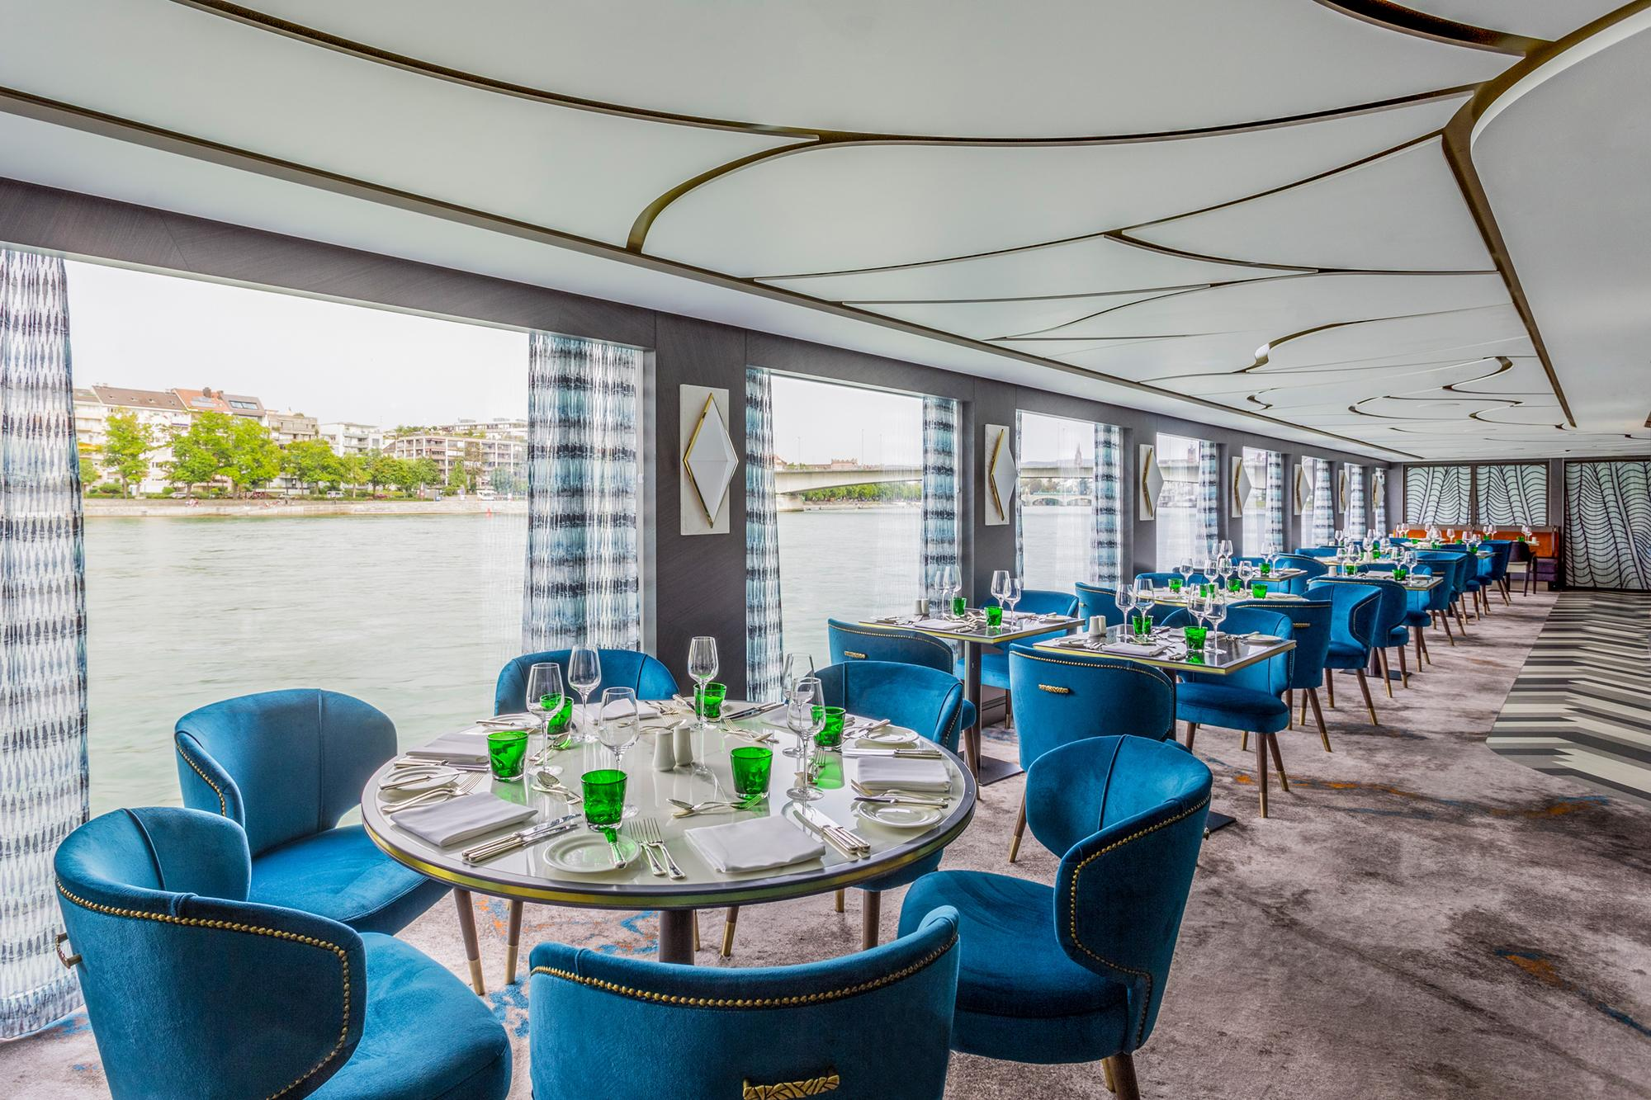
The
Restaurant

Slide 4
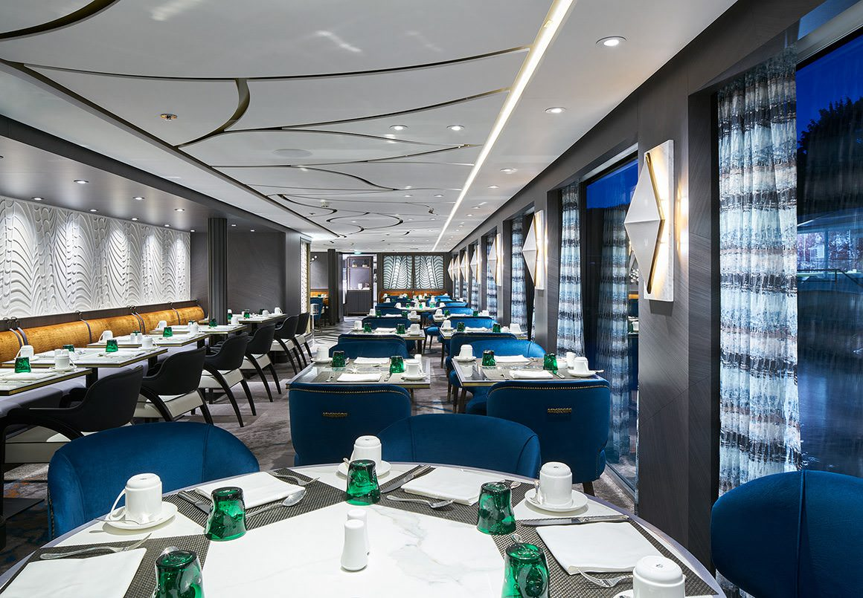
The
Restaurant

Slide 5
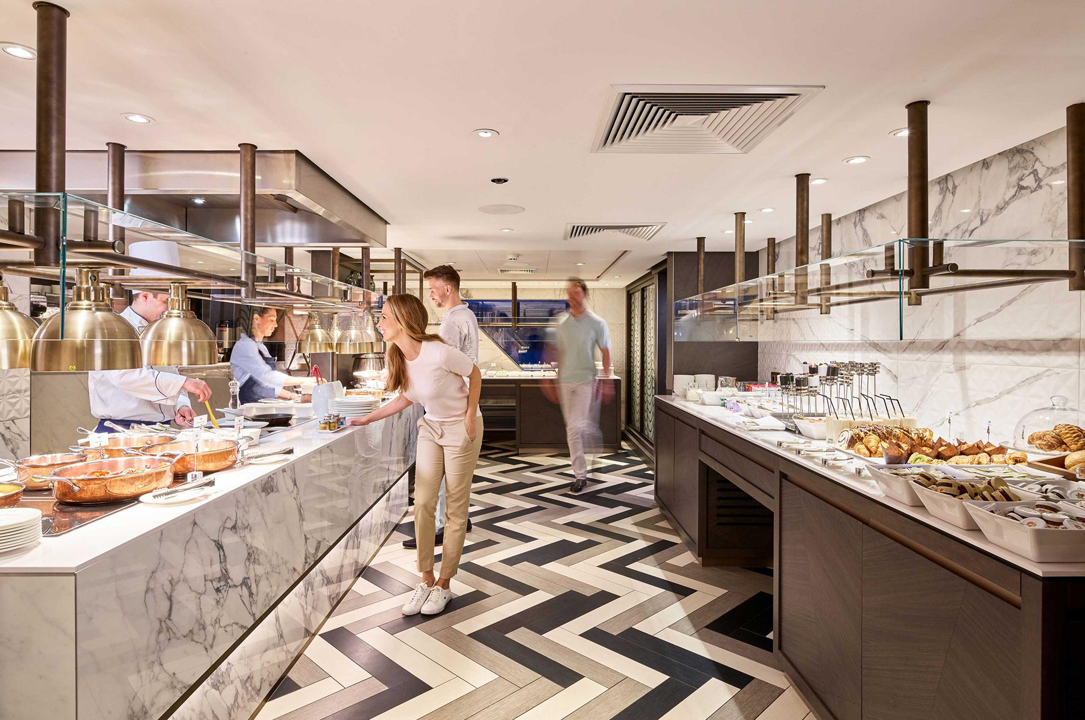
The Restaurant

Slide 6
Skylight

Slide 7
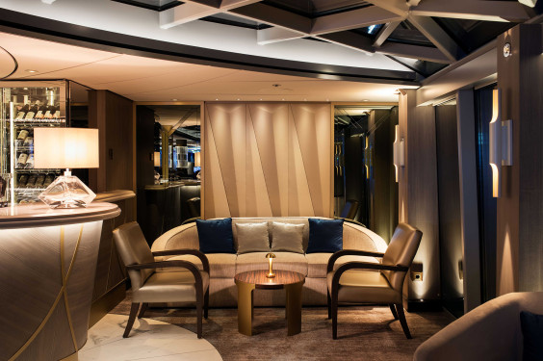
Skylight

Slide 8
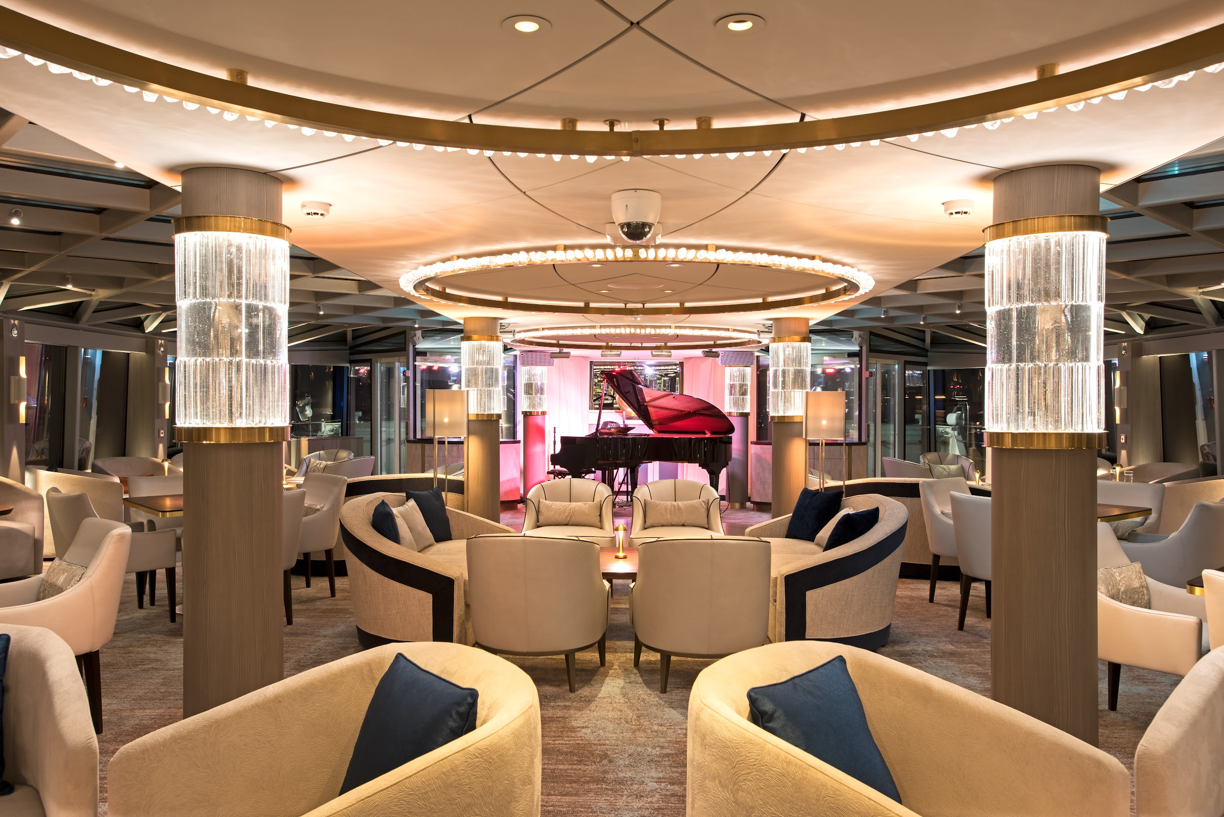
Skylight

Slide 9
Skylight

Slide 10
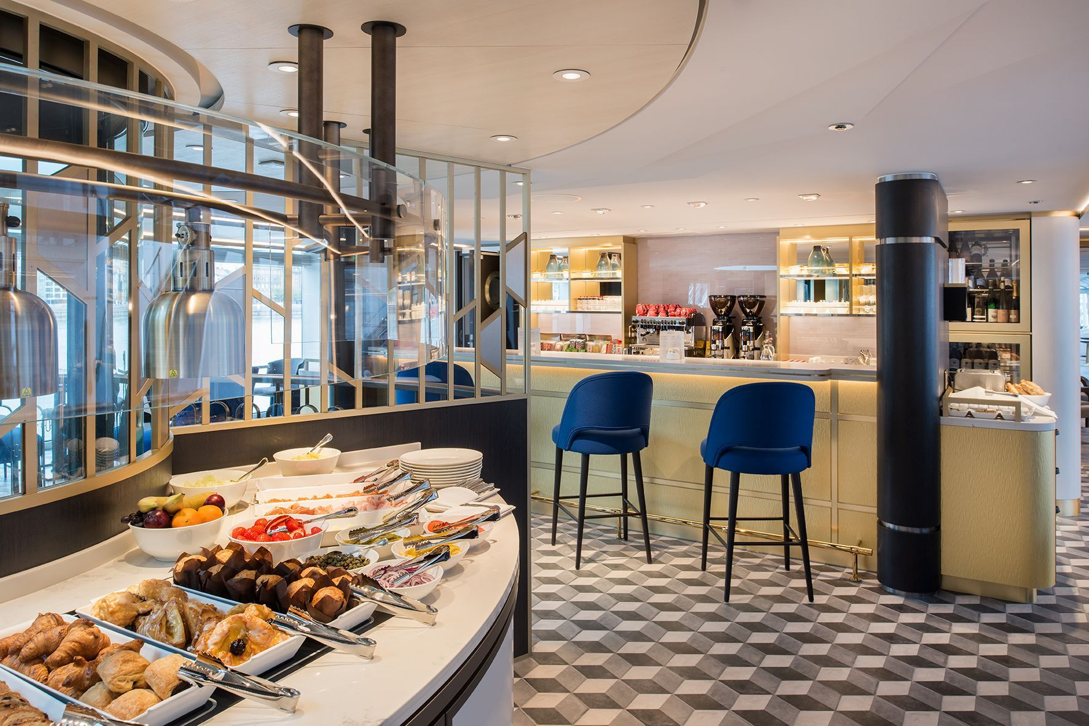
The Bistro

Slide 11
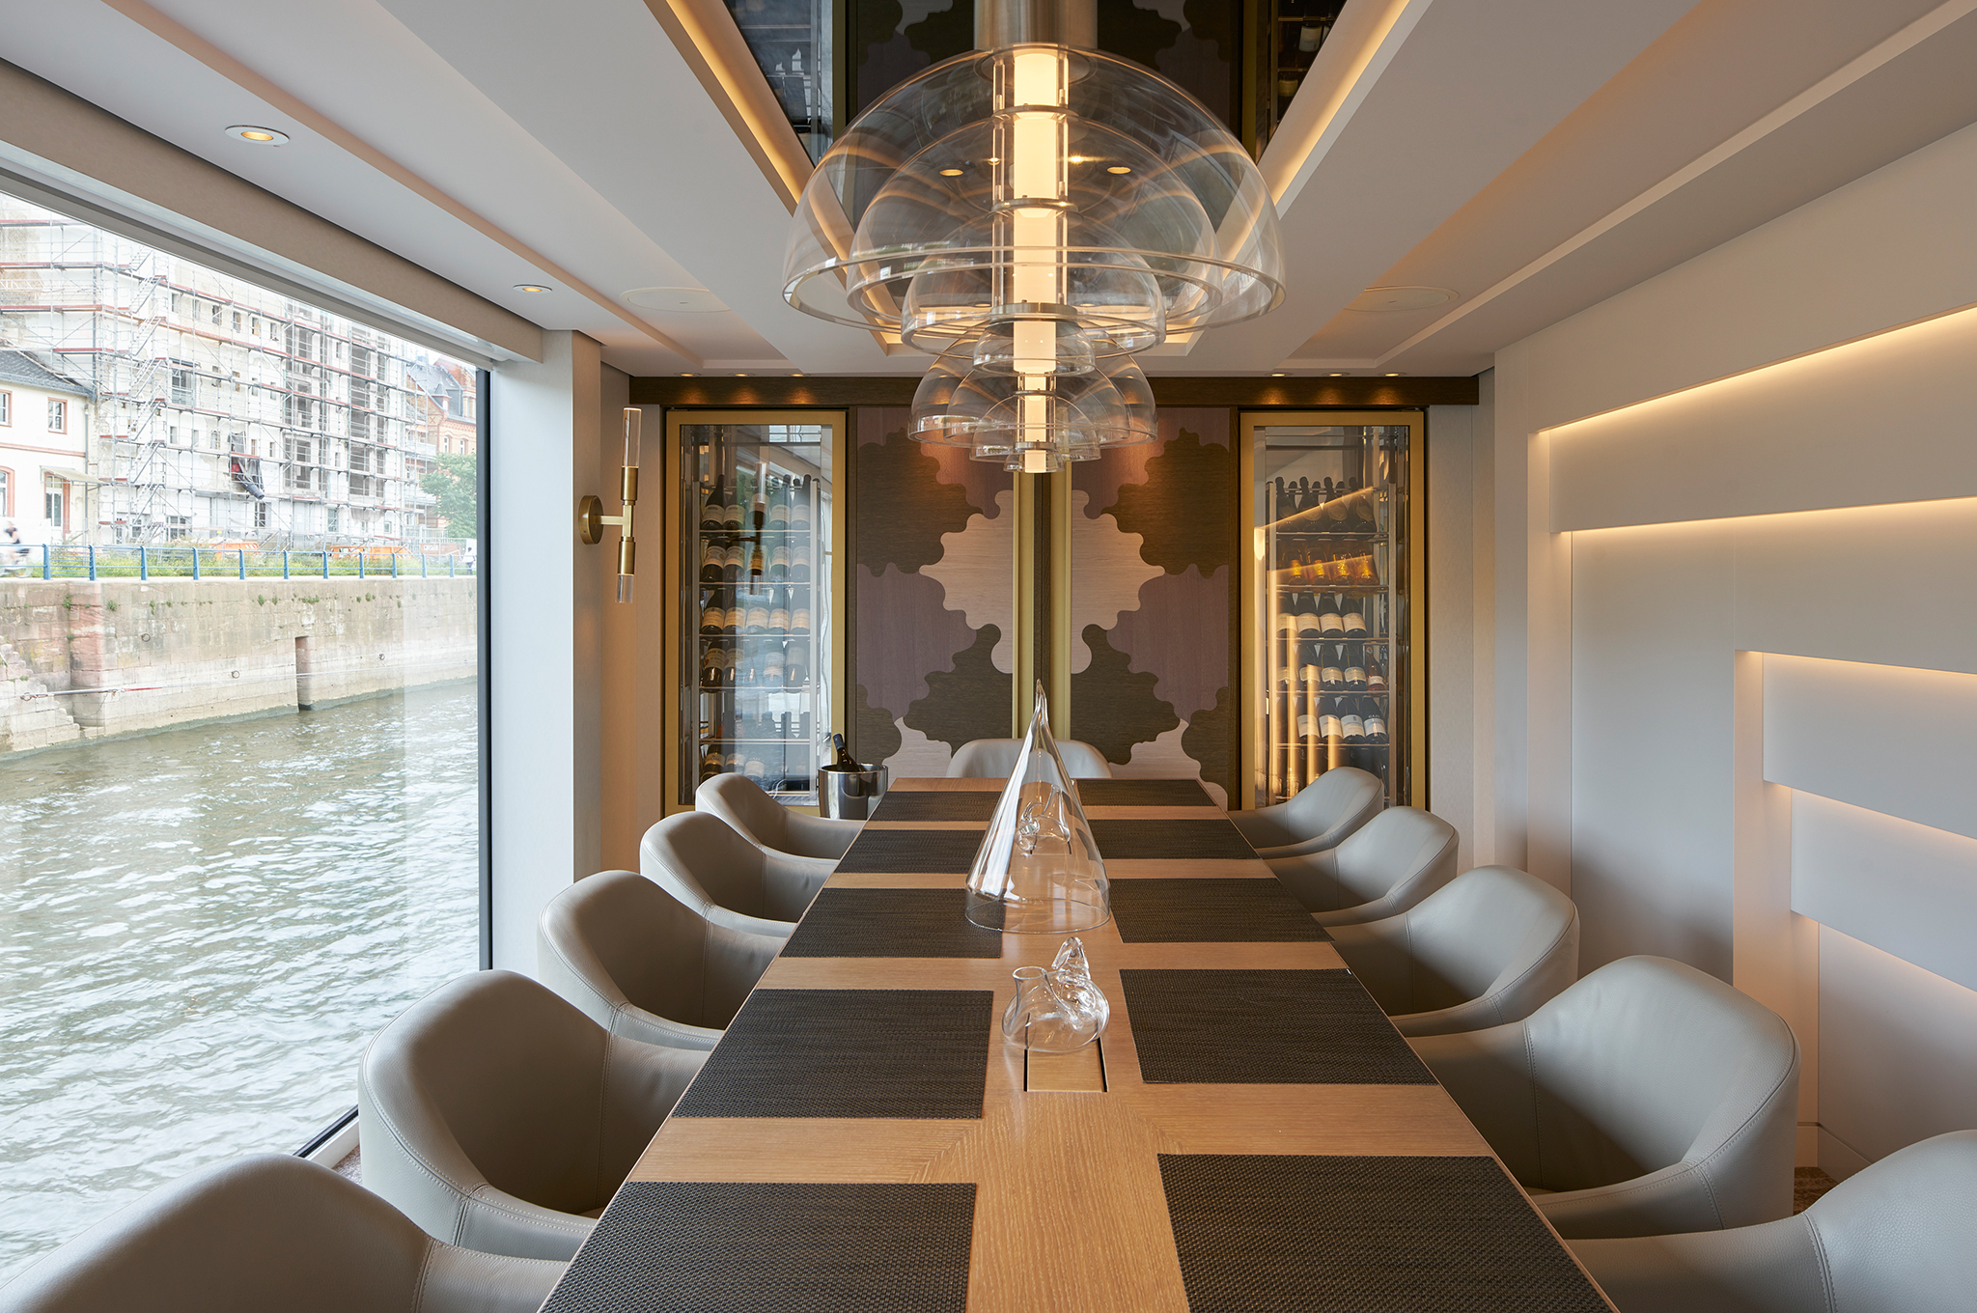
The Table

Slide 12
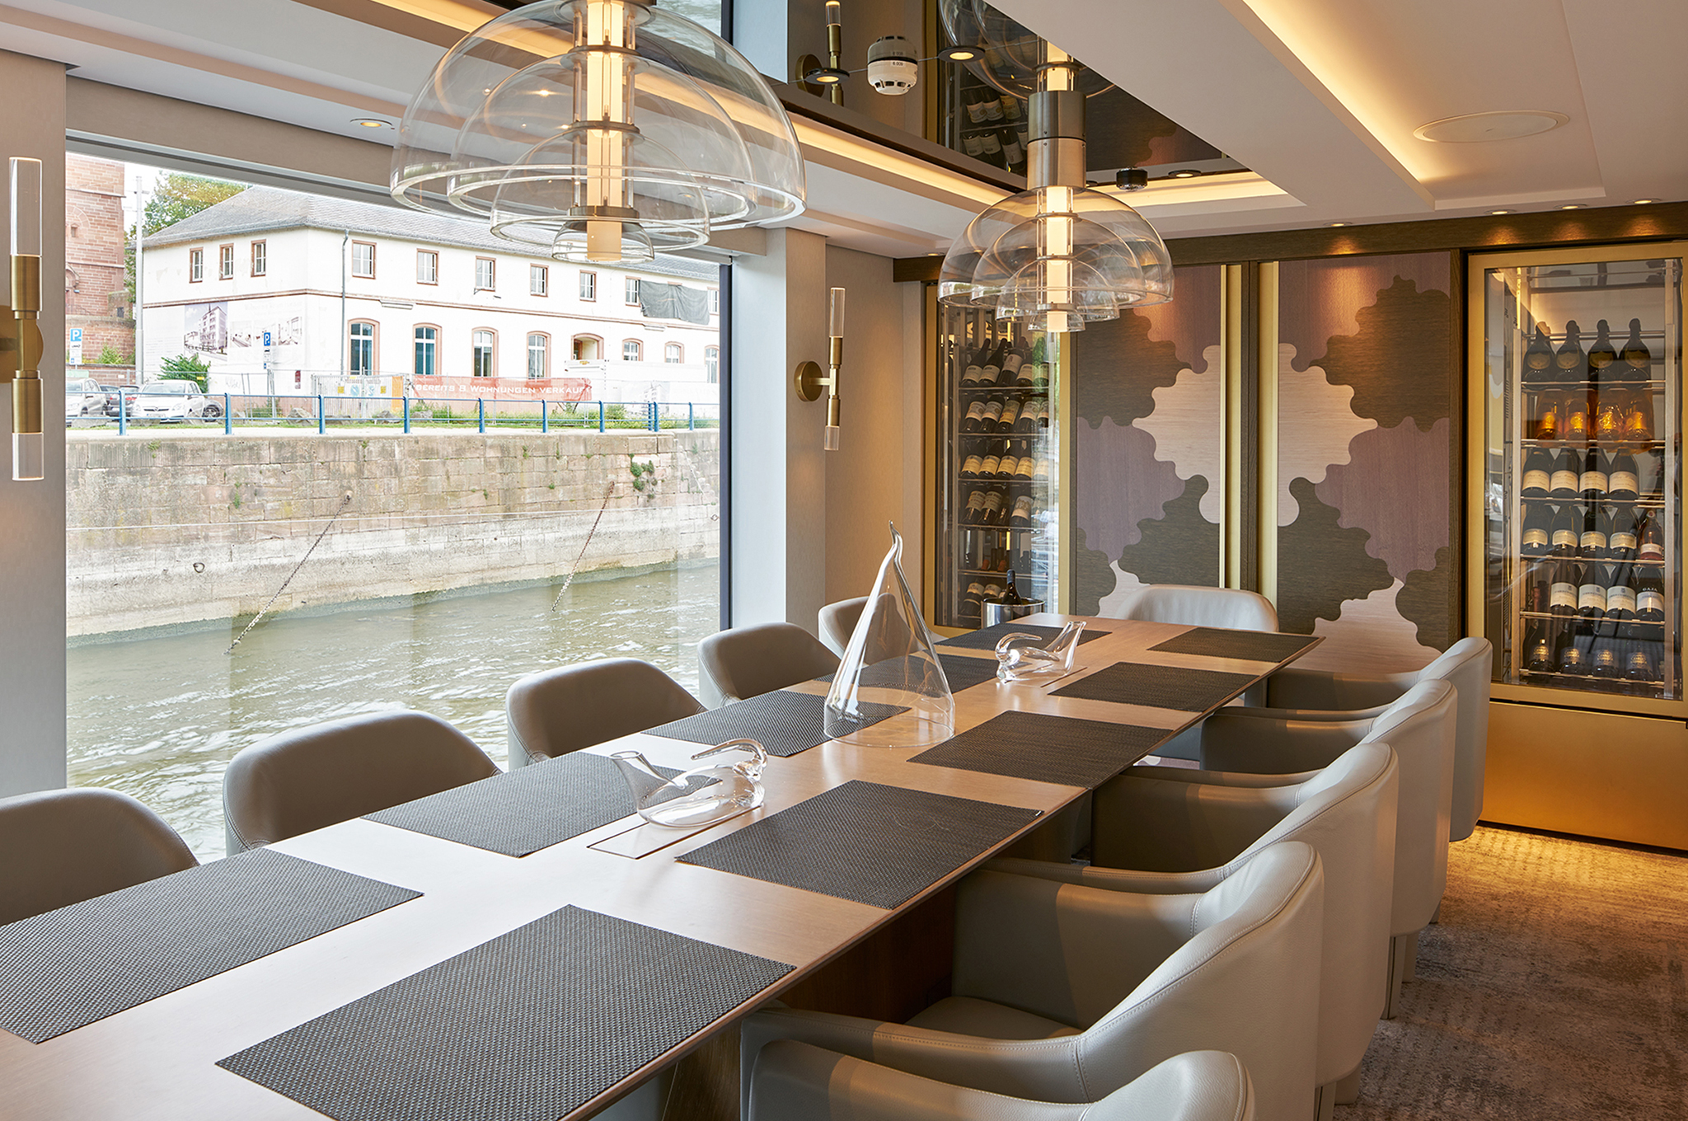
The Table

Slide 13
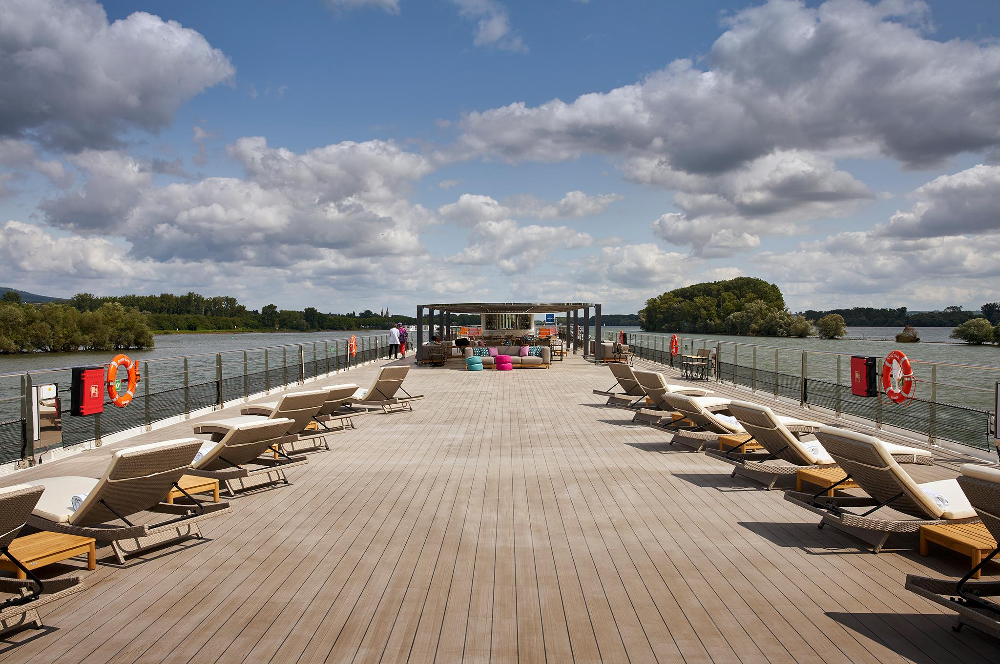
Top Deck

Slide 14
Top Deck

Slide 15
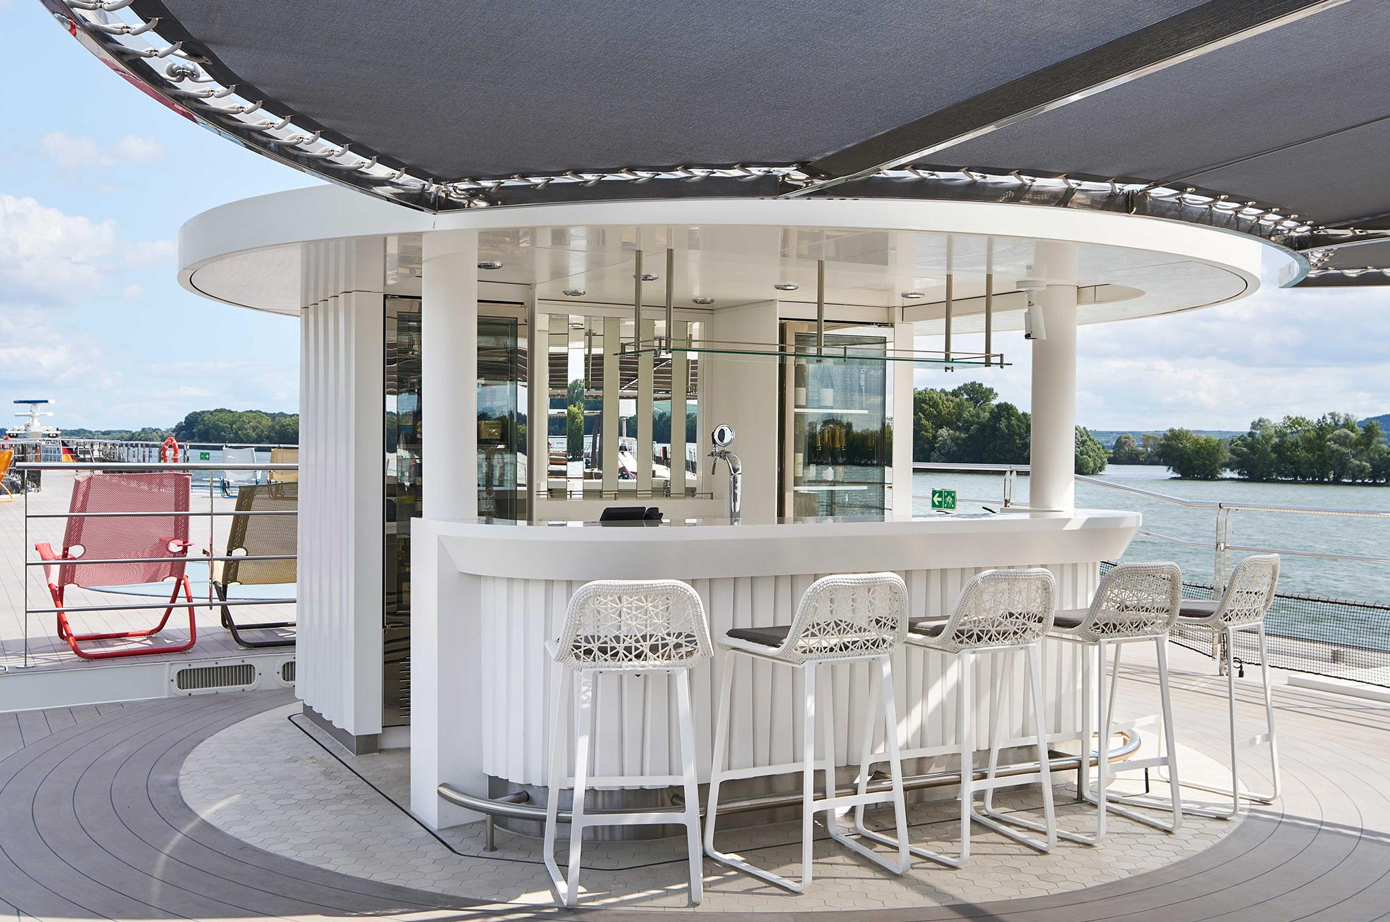
Top Deck

Slide 16
Indoor Spa Pool

Slide 17
Large Stateroom

Slide 18
Large Stateroom

Slide 19
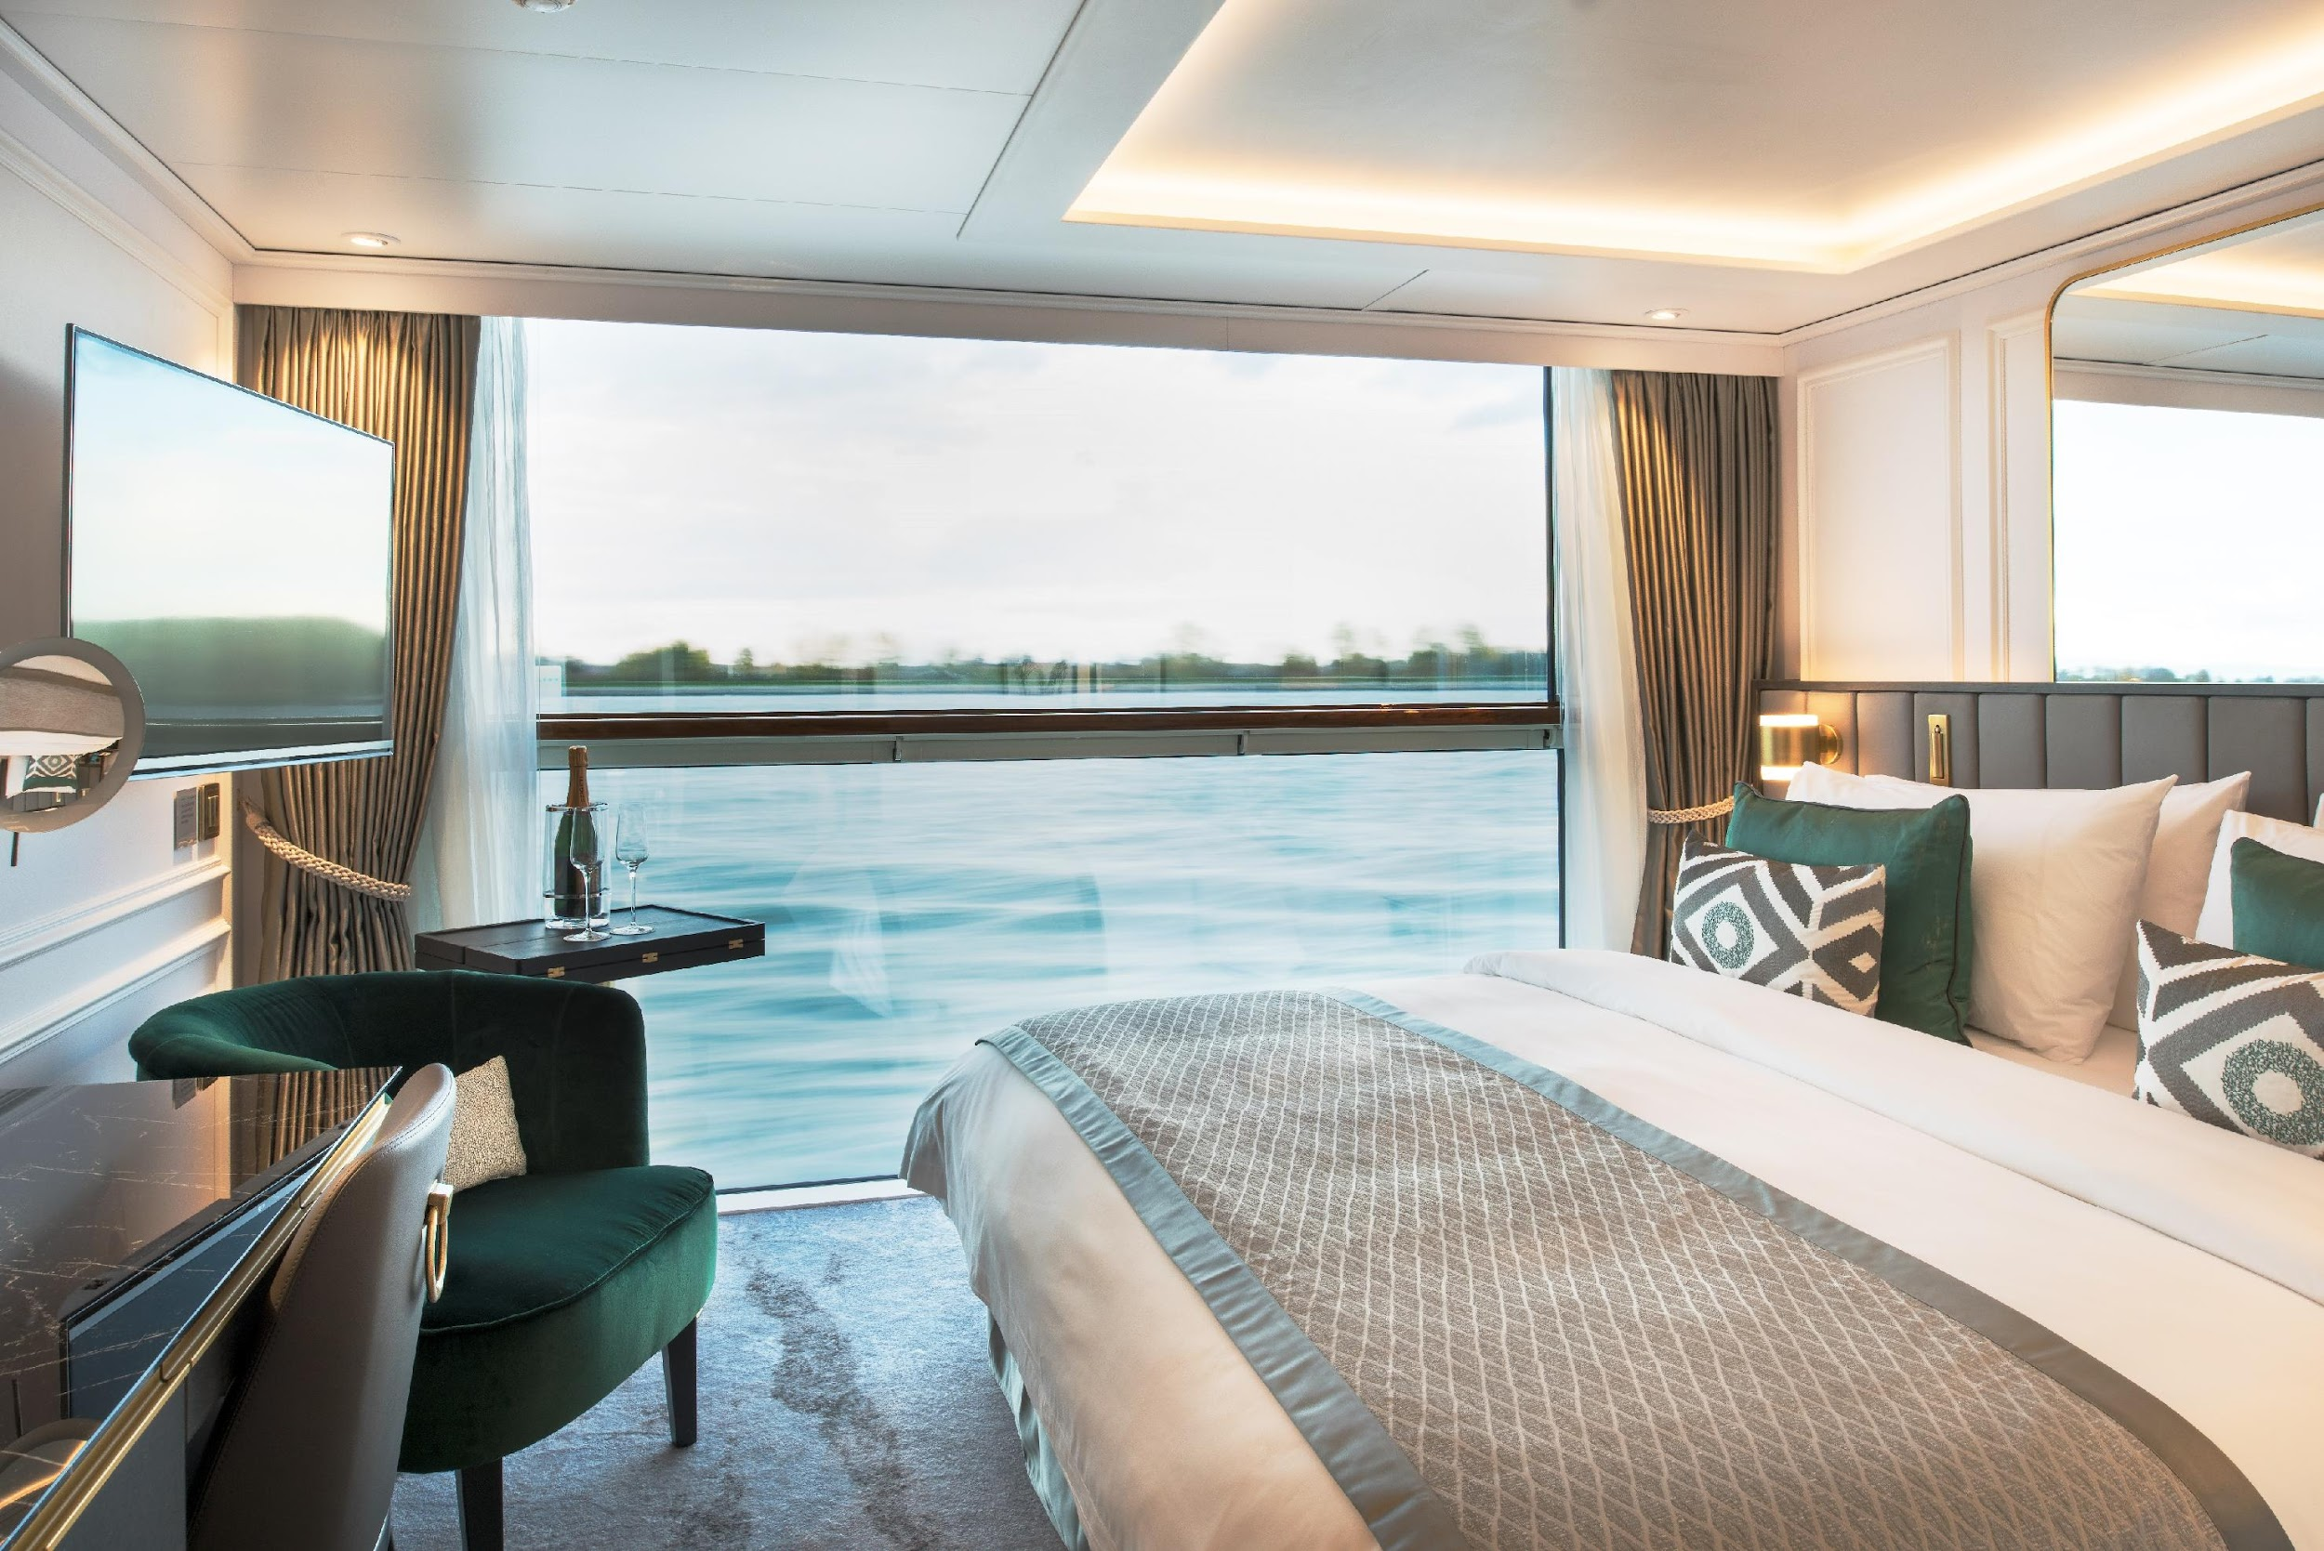
Stateroom

Slide 20
Stateroom

Slide 21
Advance Suite

Slide 22
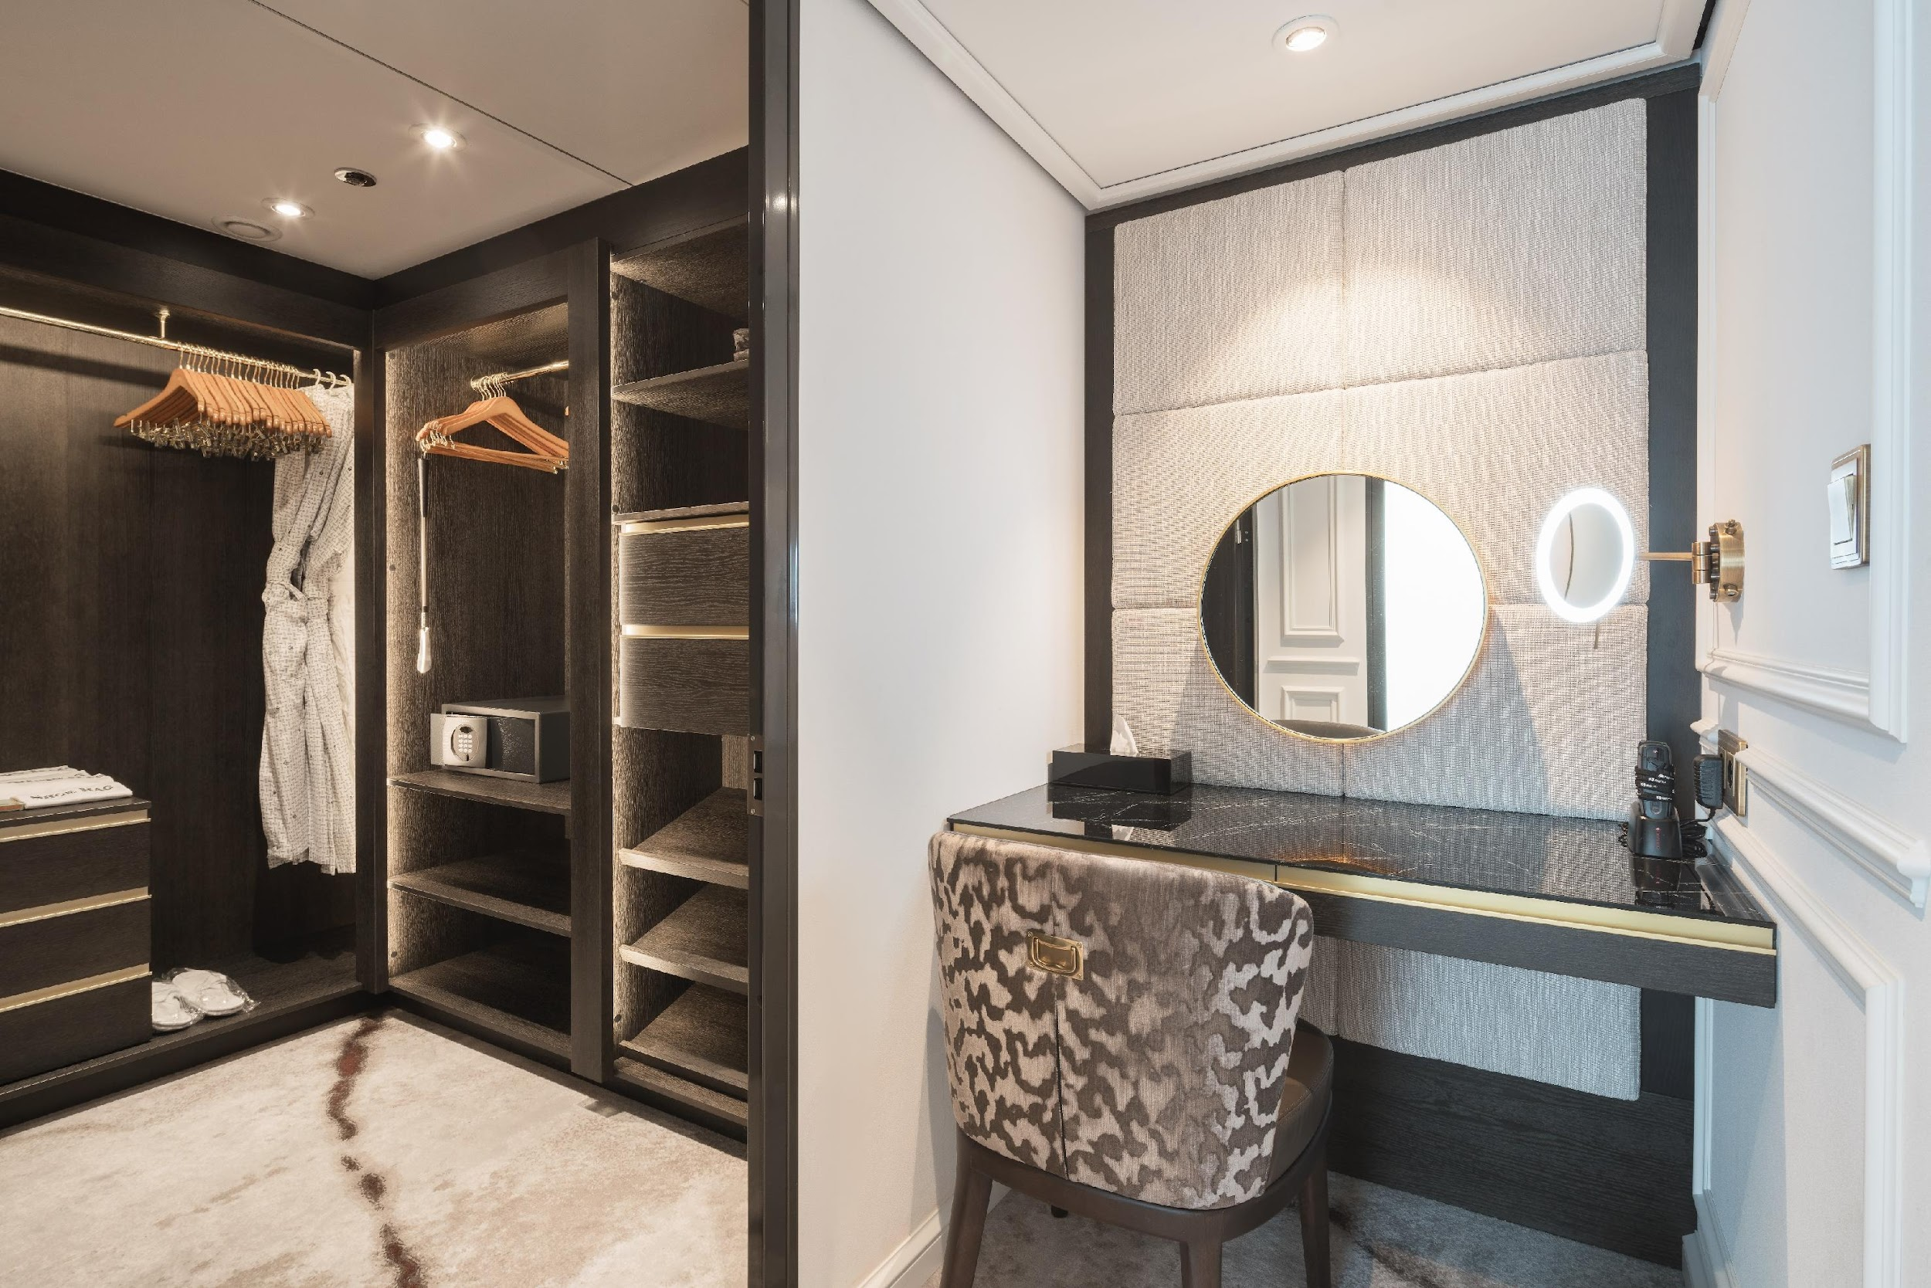
Advance Suite

Slide 23
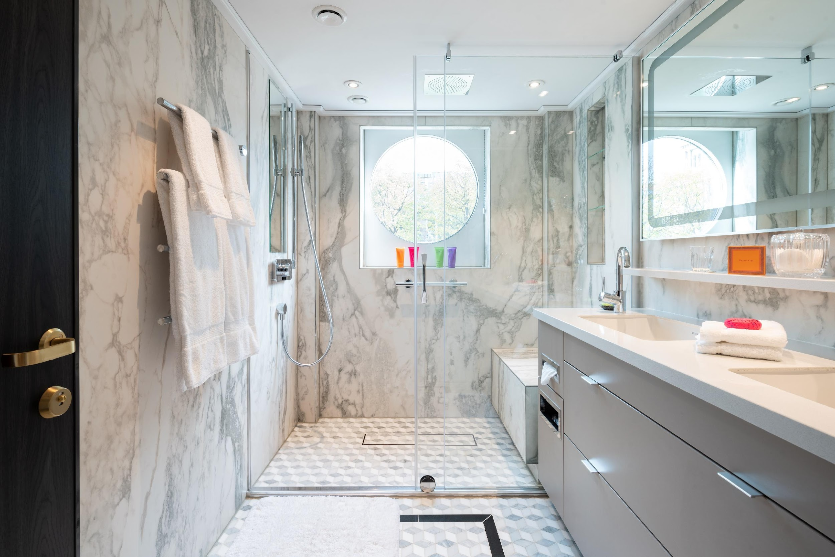
Advance Suite

Slide 24
Advance Suite

Slide 25
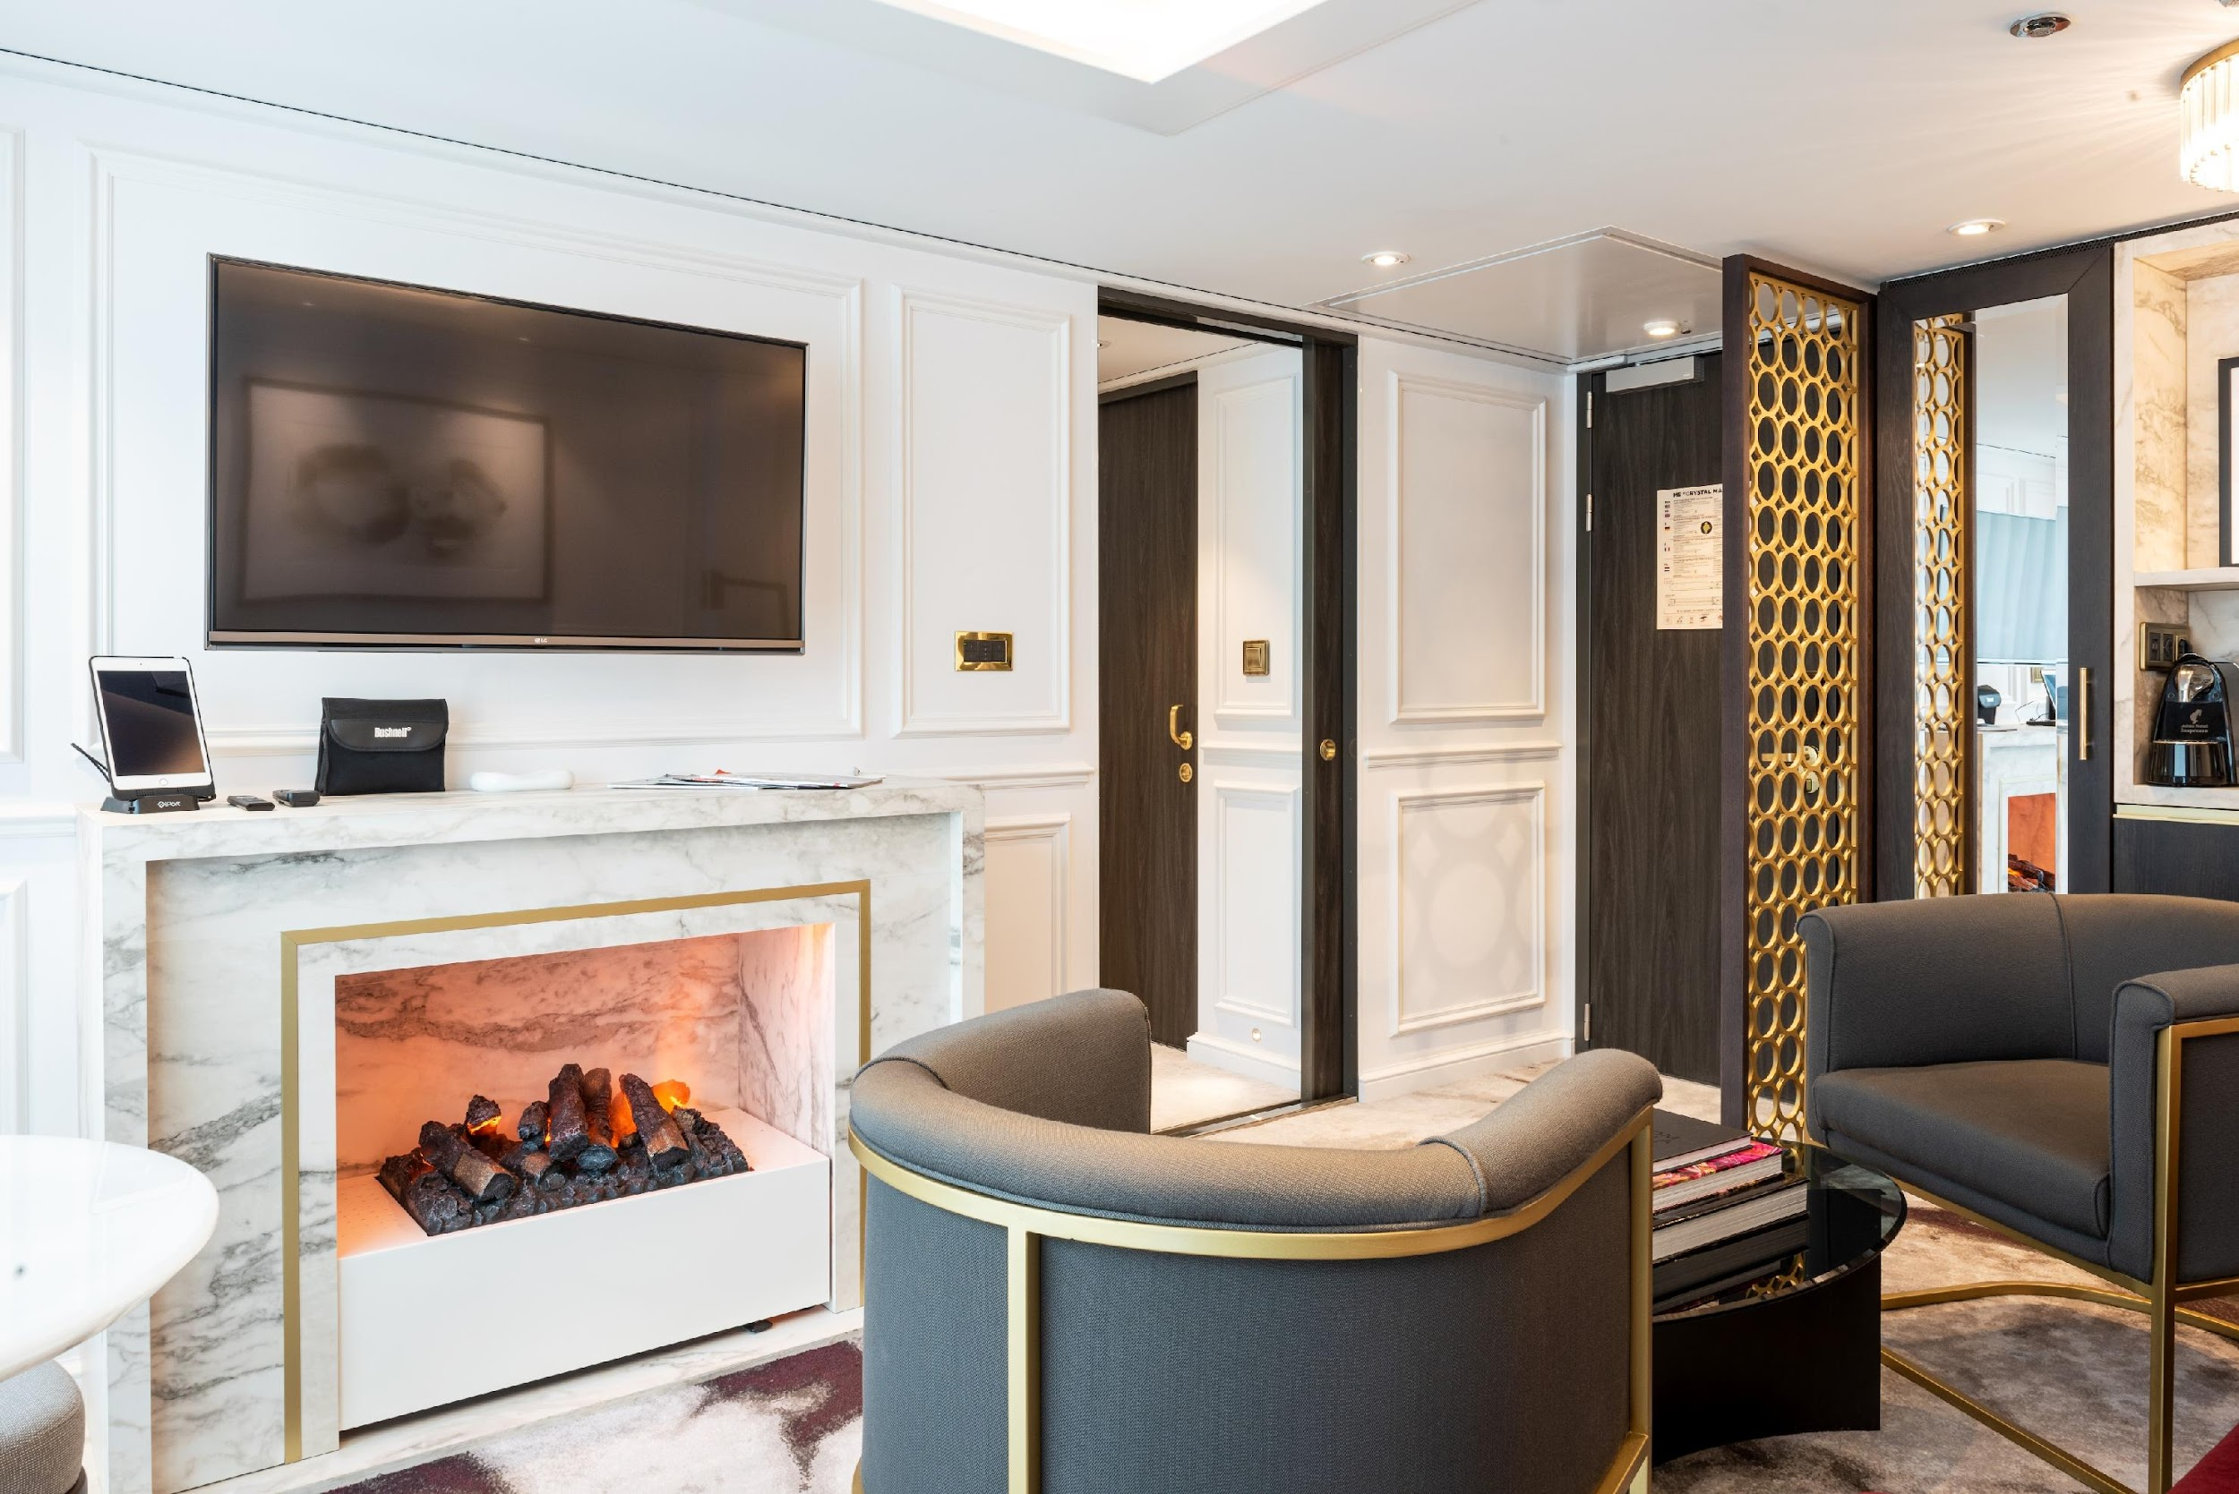
Advance Suite

Slide 26
